Slide 1


Predicting Coupon Acceptance on E-Commerce Platforms
By: Jyoti Sahu

Slide 2
Data Exploration
1
Dataset Size
2
Key Features
A substantial dataset with 12,684 rows and 25 columns allows for robust analysis.
Crucial features span coupon specifics, demographics (occupation, income, age), location (coffee shops, bars, restaurants), and context (driving time, passenger, temperature, destination, weather, direction).
3
Target Variable
4
Unique Values
The target variable, 'Accept(Y/N)?', indicates coupon acceptance in a binary yes/no format.
Analyzing unique values aids in data understanding and error detection, which is essential for data cleaning.

Slide 3
Data Cleaning
1
Missing Values
2
Duplicate Records
Impute missing values in categorical columns using appropriate methods.
Identify and remove duplicate records to maintain data accuracy.
Data Visualization
Visualize the distribution of independent variables.
Analyze the relationship between coupon acceptance and independent variables.

Slide 4
Data Visualization
Key observations from the data:
Relaxed Travelers
Most customers are not in a hurry to reach their destination, and they often travel alone on sunny days.
Coupon Preferences
Customers typically use coupons at coffee shops and restaurants, with an average spend of less than $20. However, these coupons often have a short 1-day expiration.
Customer Demographics
The majority of customers are female, between 21-31 years old, married, and have some college education but no degree. Most are unemployed with an income range of $25,000 - $37,499.
Spending Habits
Customers visit coffeehouses less than once a month or 1-3 times a month, and order takeout food 1-3 times a month. They tend to visit restaurants 1-3 times per month, spending around $20 on average. Those who visit restaurants less than once a month have a higher average spend of $20-$50.

Slide 5




Feature Engineering
Generated driving time feature
Applied LabelEncoder to categorical features
Scaled columns using StandardScaler

Slide 6
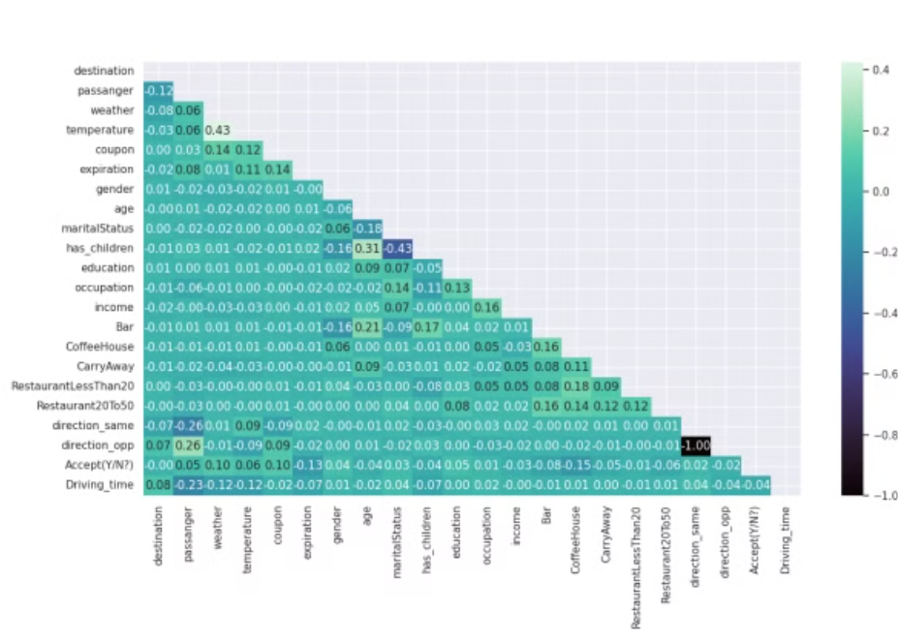
EDA
The analysis revealed no significant correlation between the independent variables.
A weak correlation was observed between the target variable and the independent variables.

Slide 7
Model Building
The following models were built and evaluated:
1
Logistic Regression
2
Decision Tree
3
Random Forest
4
Bagging
5
Boosting
6
Gradient Boosting
7
AdaBoost
8
XGBoost
9
KNN
10
SVM

Slide 8
Model Training and Evaluation
Data Splitting
80% training, 20% testing split for model evaluation.
1
2
Hyperparameter Tuning
Used GridSearchCV to optimize model parameters

Slide 9





Model Evaluation
Accuracy
Evaluate model performance using accuracy score
Precision & Recall
Analyze precision and recall metrics
Confusion Matrix
Visualize the confusion matrix for each model
Cross Validation Technique/ K-Fold method
Used for overfitting
ROC_AUC_Score/ ROC_Curve
For TPR v/s FPR comparison

Slide 10
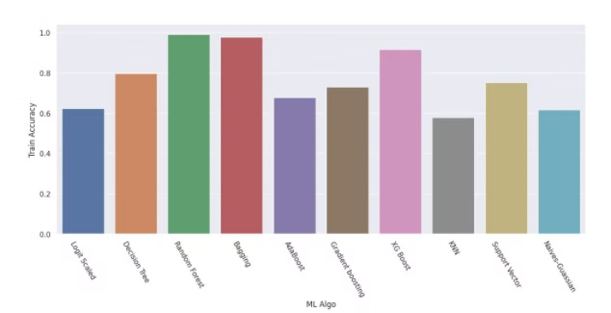
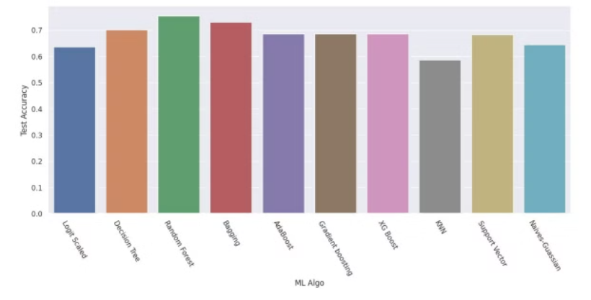
Accuracy of ML Algorithms
Training Accuracy
Test Accuracy
Random Forest demonstrates the highest accuracy on the training dataset, achieving a score of 0.99.
Random Forest also exhibits the highest accuracy on the test dataset, with a score of 0.75.

Slide 11
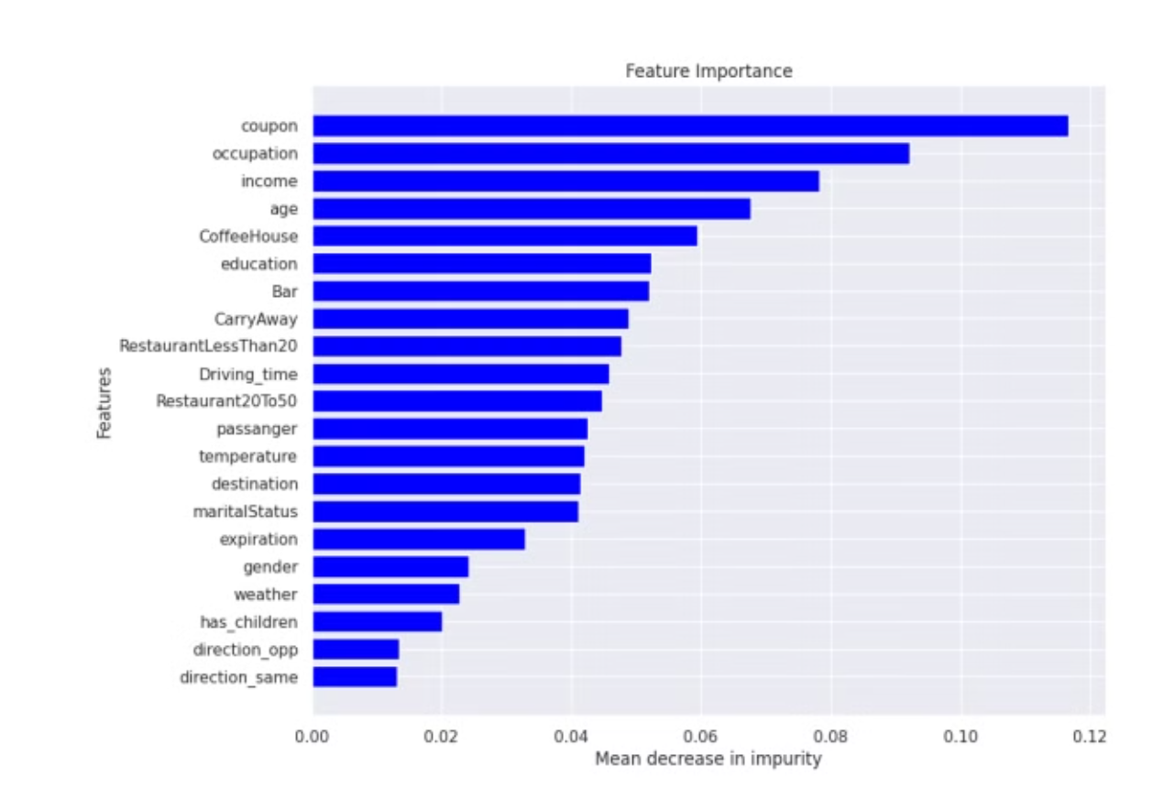
Important Features

Slide 12
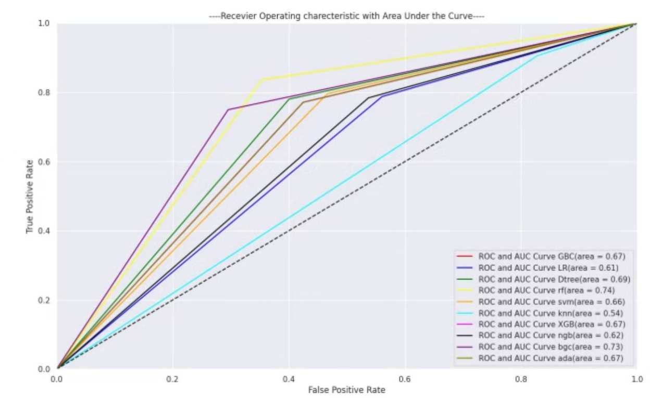
ROC_CURVE of Test dataset

Slide 13



Conclusion
Model Selection
Overfitting Issue
Most Important Feature
Random Forest emerged as the top-performing model after comparing the performance of all evaluated models.
The Random Forest model exhibits signs of overfitting.
Coupon Type
However, decision tree with hyperparameter tuning (criterion='gini' & max_depth=10) provides a balanced accuracy:
Training Accuracy: 0.79
Test Accuracy: 0.70

Slide 14


